Slide 1
Lecture 4: Covariance matrices
Learning objectives:
Three ways to understand a covariance matrix
Cholesky
Eigen-decomposition
Covariance function

Slide 2
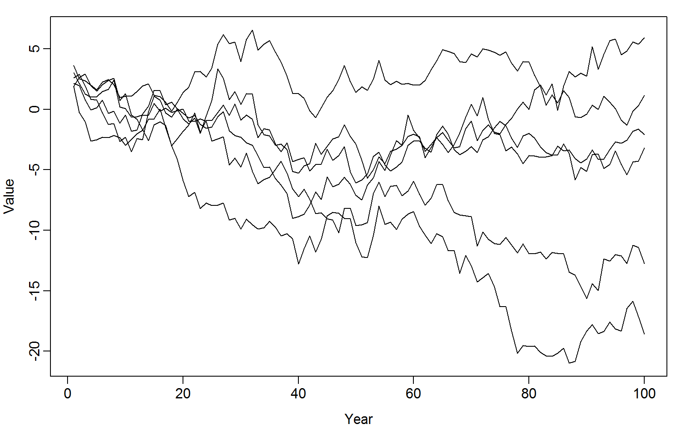
Given timeseries from multiple populations…

Slide 3
Questions:
How to tell if populations have positively correlated dynamics?
What is the average trend?
How to forecast future changes?

Slide 4
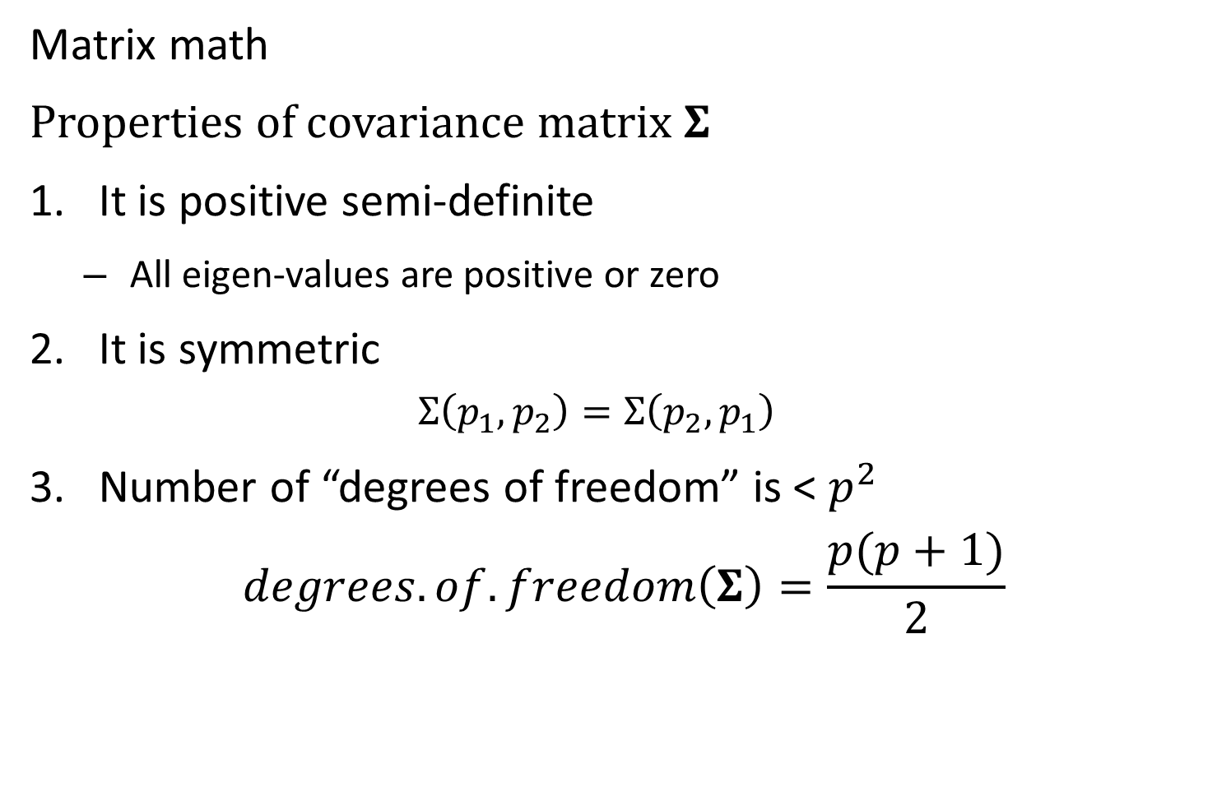
Matrix math
Properties of covariance matrix $Σ$
It is positive semi-definite
All eigen-values are positive or zero
It is symmetric
$$Σ\left(p_{1},p_{2}\right)=Σ\left(p_{2},p_{1}\right)$$
Number of “degrees of freedom” is < $p^{2}$
$$degrees.of.freedom\left(Σ\right)=\frac{p(p+1)}{2}$$

Slide 5
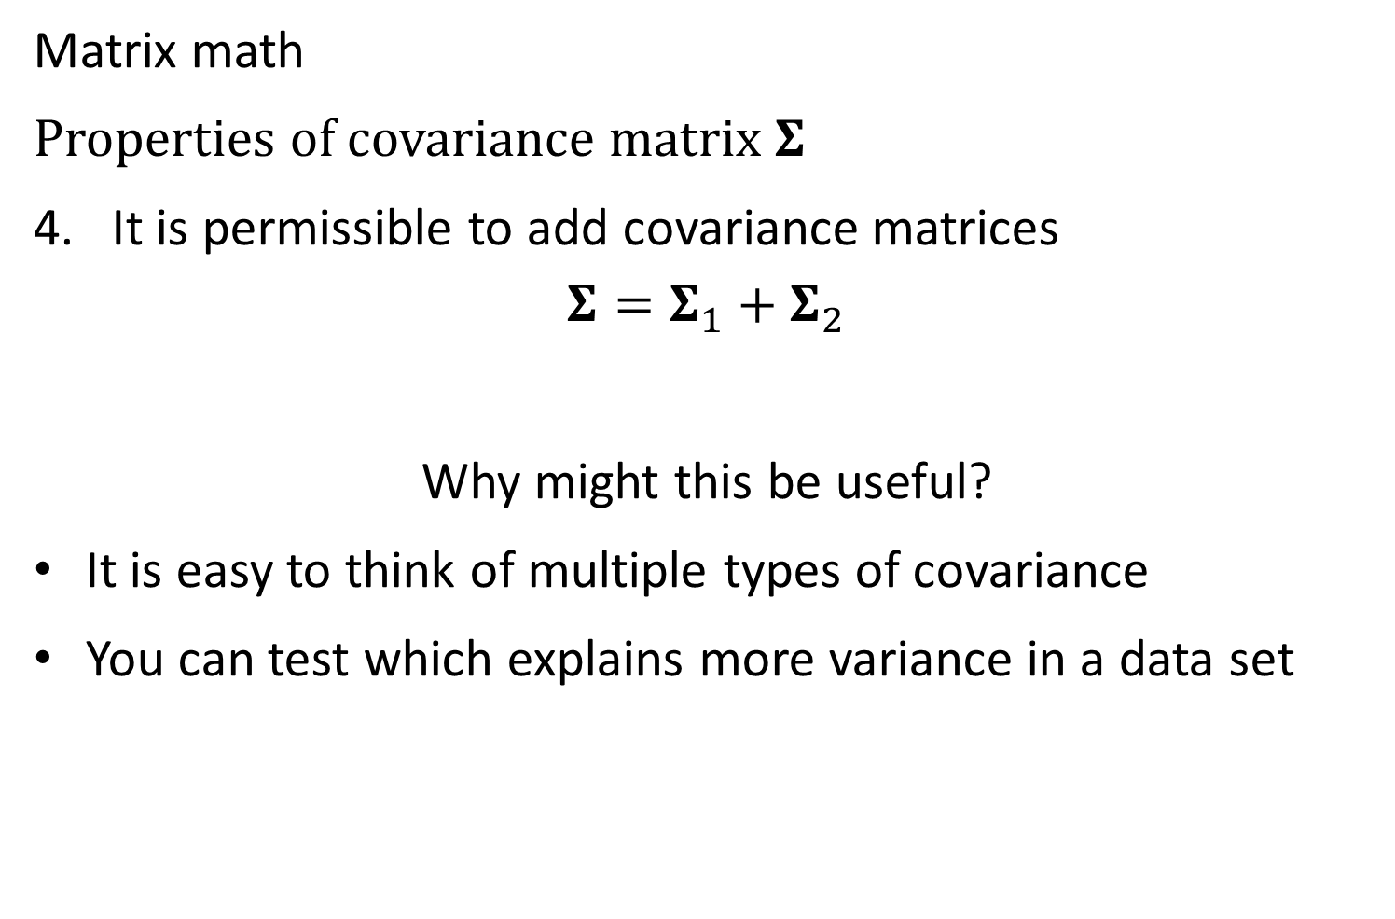
Matrix math
Properties of covariance matrix $Σ$
It is permissible to add covariance matrices
$$Σ=Σ_{1}+Σ_{2}$$
Why might this be useful?
It is easy to think of multiple types of covariance
You can test which explains more variance in a data set

Slide 6
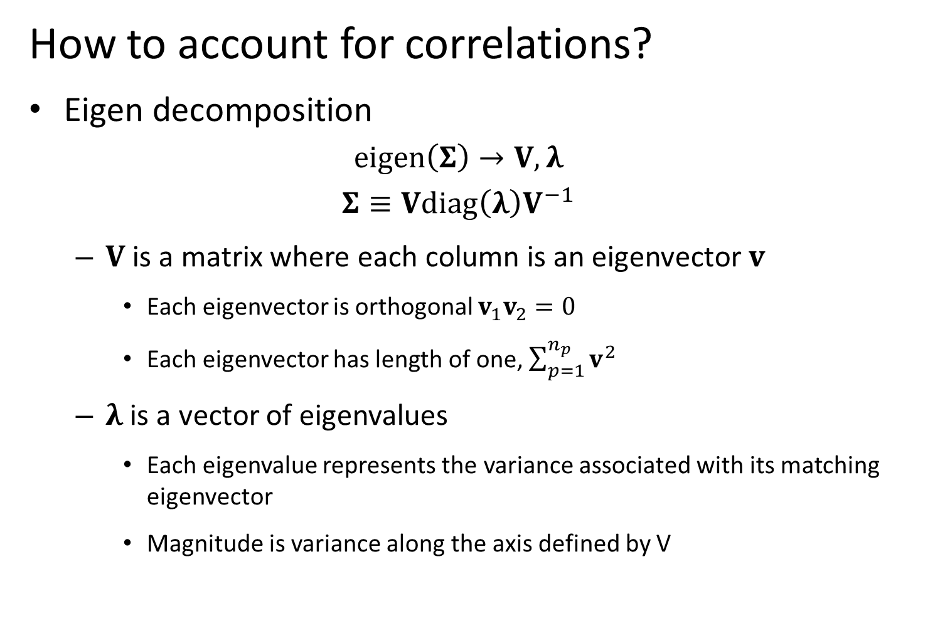
Community distribution models
How to account for correlations?
Eigen decomposition
$$eigen\left(Σ\right)→V,λ$$
$$Σ≡Vdiag\left(λ\right)V^{−1}$$
$V$ is a matrix where each column is an eigenvector $v$
Each eigenvector is orthogonal $v_{1}v_{2}=0$
Each eigenvector has length of one, $\sum_{p=1}^{n_{p}}{v^{2}}$
$λ$ is a vector of eigenvalues
Each eigenvalue represents the variance associated with its matching eigenvector
Magnitude is variance along the axis defined by V
Notes:
Predicting rare/undersampled species, bycatch etc.

Slide 7
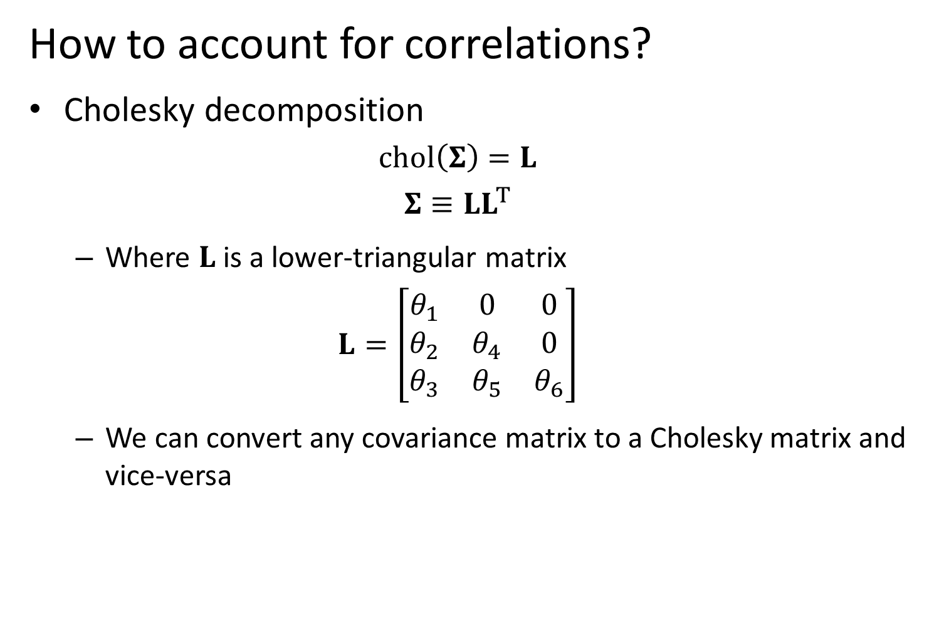
Community distribution models
How to account for correlations?
Cholesky decomposition
$$chol\left(Σ\right)=L$$
$$Σ≡LL^{T}$$
Where $L$ is a lower-triangular matrix
$$L=\left[\begin{matrix}θ_{1} & 0 & 0 \\ θ_{2} & θ_{4} & 0 \\ θ_{3} & θ_{5} & θ_{6}\end{matrix}\right]$$
We can convert any covariance matrix to a Cholesky matrix and vice-versa
Notes:
But is actually upper in R

Slide 8
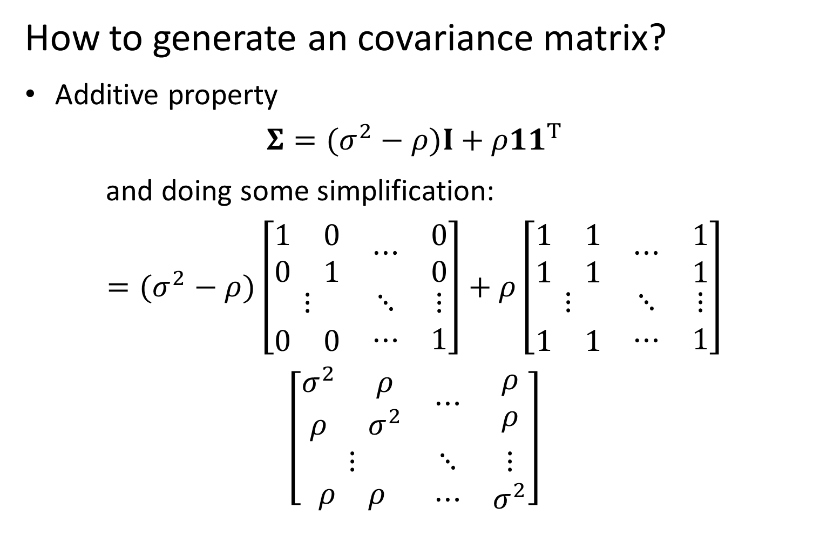
Community distribution models
How to generate an covariance matrix?
Additive property
$$Σ=(σ^{2}−ρ)I+ρ11^{T}$$
and doing some simplification:
$$=(σ^{2}−ρ)\left[\begin{matrix}\begin{matrix}1 & 0 \\ 0 & 1\end{matrix} & ⋯ & \begin{matrix}0 \\ 0\end{matrix} \\ ⋮ & ⋱ & ⋮ \\ \begin{matrix}0 & 0\end{matrix} & ⋯ & 1\end{matrix}\right]+ρ\left[\begin{matrix}\begin{matrix}1 & 1 \\ 1 & 1\end{matrix} & ⋯ & \begin{matrix}1 \\ 1\end{matrix} \\ ⋮ & ⋱ & ⋮ \\ \begin{matrix}1 & 1\end{matrix} & ⋯ & 1\end{matrix}\right]$$
$$\left[\begin{matrix}\begin{matrix}σ^{2} & ρ \\ ρ & σ^{2}\end{matrix} & ⋯ & \begin{matrix}ρ \\ ρ\end{matrix} \\ ⋮ & ⋱ & ⋮ \\ \begin{matrix}ρ & ρ\end{matrix} & ⋯ & σ^{2}\end{matrix}\right]$$
Notes:
Predicting rare/undersampled species, bycatch etc.

Slide 9
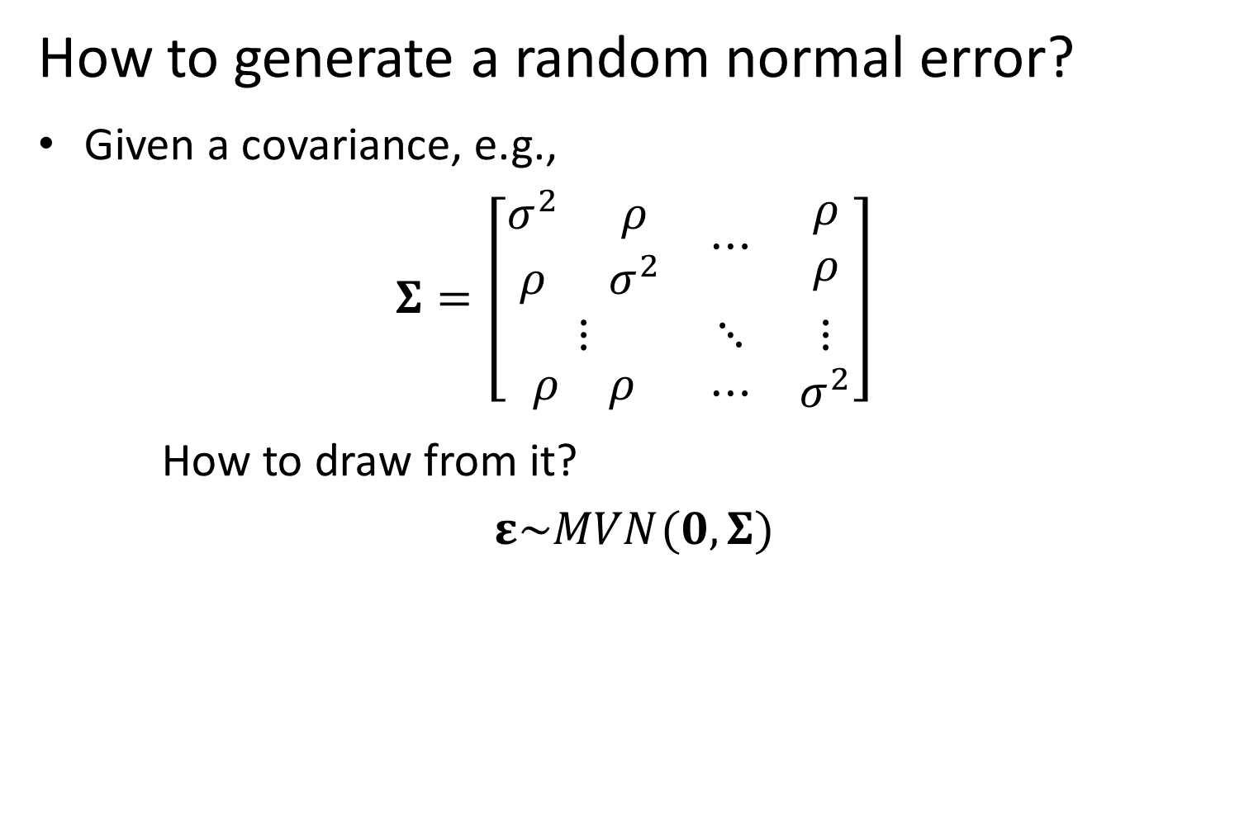
Community distribution models
How to generate a random normal error?
Given a covariance, e.g.,
$$Σ=\left[\begin{matrix}\begin{matrix}σ^{2} & ρ \\ ρ & σ^{2}\end{matrix} & ⋯ & \begin{matrix}ρ \\ ρ\end{matrix} \\ ⋮ & ⋱ & ⋮ \\ \begin{matrix}ρ & ρ\end{matrix} & ⋯ & σ^{2}\end{matrix}\right]$$
How to draw from it?
$$ε\sim MVN(0,Σ)$$
Notes:
Predicting rare/undersampled species, bycatch etc.

Slide 10

Community distribution models
How to generate a random normal error?
Given
$$ε\sim MVN(0,Σ)$$
Then doing some math
$$δ\sim MVN(0,I)$$
$$ε=Lδ$$
Why does this work?
Notes:
Use the Cholesky decomposition
Can use to make model separable, so it runs faster

Slide 11

Multivariate random walk
$$x_{t+1}\sim MVN(x_{t},Σ_{x})$$
Where
$$Σ_{x}=(σ^{2}−ρ)I+ρ11^{T}$$
$$ρ=0.2$$
$$σ^{2}=0.7$$

Slide 12
Multivariate random walk
[See code]

Slide 13

Can we predict covariance from location?
Define a covariance function
$$V\left(s_{1},s_{2}\right)$$
Where $s_{1}$ and $s_{2}$ are locations
Distance $d\left(s_{1},s_{2}\right)$

Slide 14

Can we predict covariance from location?
Define a covariance function
Exponential function
$$V\left(s_{1},s_{2}\right)=σ^{2}exp⁡(−κd\left(s_{1},s_{2}\right))$$
Gaussian function
$$V\left(s_{1},s_{2}\right)=σ^{2}exp⁡(−κd{\left(s_{1},s_{2}\right)}^{2})$$
Matern function
Spherical function
Etc.
Notes:
No nugget here, but could generate with an additive covariance function
Sig2
K controls the range

Slide 15

Can we predict covariance from location?
Define a covariance function
$$Σ=\left[\begin{matrix}\begin{matrix}V\left(s_{1},s_{1}\right) & V\left(s_{1},s_{2}\right) \\ V\left(s_{1},s_{2}\right) & V\left(s_{2},s_{2}\right)\end{matrix} & ⋯ & \begin{matrix}V\left(s_{1},s_{n}\right) \\ V\left(s_{2},s_{n}\right)\end{matrix} \\ ⋮ & ⋱ & ⋮ \\ \begin{matrix}V\left(s_{1},s_{n}\right) & V\left(s_{2},s_{n}\right)\end{matrix} & ⋯ & V\left(s_{n},s_{n}\right)\end{matrix}\right]$$
Notes:
Diagonal goes to sigma2

